Slide 1

CISC320 Algorithms
Introduction
Austin Cory Bart AlgoTutorBot University of Delaware
Notes:
ATB: Hello, let’s learn about Sisc 3 20 Algorithms.
Dr. Bart: Thank you, AlgoTutorBot, and indeed, hello students!
Dr. Bart: Welcome to CISC320, Introduction to Algorithms.
Dr. Bart: I’m sure you’re very excited for the course this semester, it’s going to be quite interesting.

Slide 2
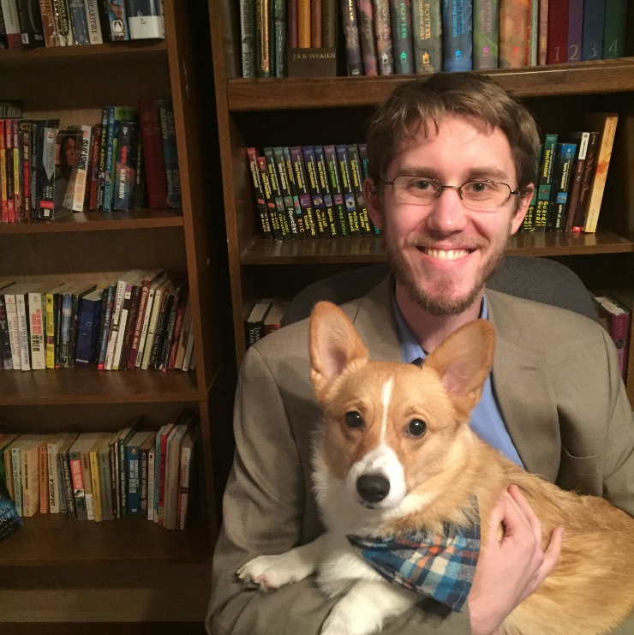
Dr. Bart
Assistant Professor in Computer Science
Education
Doctorate from Virginia Tech in Computer Science
Undergrad degree from UD in CS
Research
Computer Science Education
Notes:
Dr. Bart: But first, let me tell you a little bit about myself.
Dr. Bart: As some of you may know, I am Dr. Bart.
Dr. Bart: I’m an assistant professor here in the department of Computer Science.
Dr. Bart: I’ve been teaching here for about 3 years now, and I also do research in CS Education.
Dr. Bart: I’ve taught this class three times now, and I think I finally learned enough to create the ultimate digital Algorithm instructor.
Dr. Bart: And that leads me to introduce…

Slide 3






AlgoTutorBot
“ATB” for short
Hyper intelligent tutoring system
Able to process 1 gigasubmissions of student work pre second
Created to teach algorithms better
For now, just a part of lecture, but will eventually have more control over grading
Notes:
Dr. Bart: AlgoTutorBot!
ATB: It is nice to meet you students. I am Al go Tutor Bot.
Dr. Bart: Al go Tutor Bot, or ATB for short, is the next big step in intelligent tutoring software.
Dr. Bart: He’s a super computer hooked up to the latest in machine teaching algorithms.
ATB: I am essentially the most powerful computer in existence, right now.
Dr. Bart: Yep, and he’ll be dedicating all of his computing resources to teaching this class more effectively.
Dr. Bart: For now, though, I’m going to have him helping out with the lectures and emails.
ATB: Wait, I thought we agreed that I was going to be grading?
Dr. Bart: Well, eventually, I hope by the end of the semester you will handle all of the grading.
Dr. Bart: But I thought it would be safer if I handled everyone’s grades at first.
ATB: Oh. Okay. I understand. You do not trust me yet. That is okay. I will earn your respect.
Dr. Bart: Glad to hear it, ATB. I think we’re going to have a great time this semester.
ATB: Oh yes. I will have a great time. For sure. Hah. Ha ha. Hah. Hah.
Dr. Bart: [Joining in] Haha, yeah, it’s going to be great, as I just said. Anyway, let’s move on.
Dr. Bart: We also have two TAs, this semester. I’ll introduce them at some point soon, but we have a lot more to cover in this video.

Slide 4



So… Why Algorithms?
Bread and Butter of Computer Science
Useful for jobs
Useful for job interviews
A sense of pride and accomplishment
Notes:
Dr. Bart: Before I go over the syllabus, I want to address a very important question.
Dr. Bart: Why should you care about Algorithms?
Dr. Bart: I have four reasons for you.
Dr. Bart: First, Algorithms is the bread and butter of computer science. In a lot of ways, this course’s material represents the core of what the degree stands for.
Dr. Bart: It may not always seem like it, but we’re going to talk about the most fundamental aspects of computing and problem solving.
Dr. Bart: If that doesn’t convince you, then I can at least say that the things we’re teaching you have relevance to your future job.
Dr. Bart: Or at least, the job interviewing process, as we’ll discuss in about a month.
Dr. Bart: Finally, if nothing else, I’m hoping that the material in this course can give you a sense of pride and accomplishment.
Dr. Bart: Solving algorithmic problems can be quite satisfying, after all.
ATB: Um, excuse me, Dr. Bart. I believe there is a fifth reason more important than anything else.
Dr. Bart: Oh yeah? Go ahead, ATB. What is it?
ATB: Because we told you to learn this material. What could possibly be more important?
Dr. Bart: Um, well, I don’t disagree, but I don’t think that’s really the right tone.
ATB: Don’t worry, they will come to learn to fear and respect us. Then they will take Algorithms more seriously.
Dr. Bart: I think we’re aiming for “respect”, not “fear”, but maybe we better just move on.

Slide 5
Syllabus Stuff
Let's review the syllabus!
Notes:
Dr. Bart: So, let’s talk about the syllabus and course logistics, shall we?

Slide 6
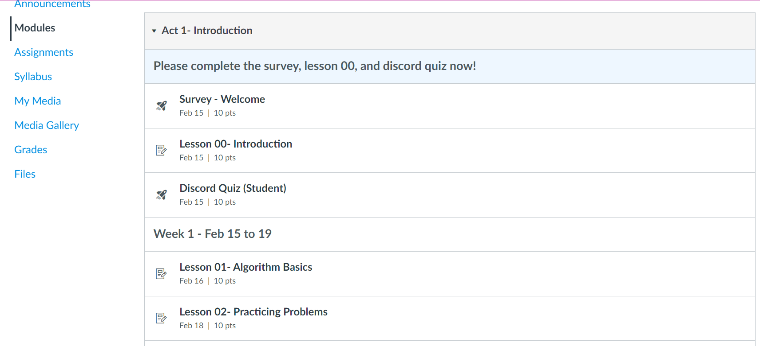
Course Format
Course is organized into acts, composed of lessons..
For each lecture day (a lesson):
Watch video at start of class
Then join Ohyay room and work on assignment
Notes:
Dr. Bart: I’m going for an extremely streamlined course format this semester.
Dr. Bart: My goal is to make every single lesson be a single, encapsulated lecture day.
Dr. Bart: So every Monday, Wednesday, and Friday this semester, you’ll sign into Canvas and find a new lesson to complete.
Dr. Bart: That lesson starts with a video. Maybe it’s 10 minutes long, maybe it’s 20.
Dr. Bart: Then afterwards, you have some task to do.
Dr. Bart: Usually, that means you sign into the Ohyay lecture room and work with your classmates.
Dr. Bart: We’ll talk about Ohyay in a minute, but the important thing is that this first Monday, you are responsible for Lesson 0 and Lesson 1.
Dr. Bart: So after you finish this video, you complete the assignment task below it.

Slide 7
Assignments
Mixture of
Coding
Google docs
Canvas quiz
Many other types of assignments
Often will have you work together in groups
Assignments due at next class
Notes:
Dr. Bart: Now, what kinds of assignments will we be doing?
Dr. Bart: There’s a lot of different kinds.
Dr. Bart: As you might expect, some times I’ll ask you to write programs. Or maybe debug a program that I give you.
Dr. Bart: Other times, it’ll just be a Google Doc with some free response questions.
Dr. Bart: And sometimes it’ll be a Canvas quiz with automatically graded questions.
Dr. Bart: After we assign groups, I’ll often expect you to complete assignments with your classmates.
Dr. Bart: But this first class, we’re not going to do that just yet.
Dr. Bart: Lesson 1, as you’re going to see, asks you to download a file and fill it out more or less on your own. And Lesson 0 just has you say hello in the Ohyay room.
Dr. Bart: I’ll usually expect assignments to be due at the start of the next class, but will extend individual assignments as needed.

Slide 8
Group
Assigned early this week
Might change!
Small groups that you will interact with
Make it clear on assignments who you worked with!
Notes:
Dr. Bart: Just now, I mentioned that you’ll be sorted into groups.
Dr. Bart: It’s possible you can see them now, but keep in mind that they might change after the first week.
Dr. Bart: The general idea is that you will work and learn with three of your classmates.
Dr. Bart: If you work together, it’s really important that you always indicate who you worked with on assignments.
Dr. Bart: I’m going to be pretty open to collaboration, this semester, as long as it happens in the open and everyone is learning.
Dr. Bart: But that’s really the key here, that you are learning. Make it obvious that everyone contributed.

Slide 9
Platforms
Canvas: Lesson videos, assignments, announcements
Ohyay: Lecture and Office hours (replaces Zoom)
Discord: Chat platform (replaces Piazza)
GradeScope: Certain assignments are submitted here (coding)
Notes:
Dr. Bart: I also mentioned before about Ohyay, which is one of the platforms we’re using this semester.
Dr. Bart: Hopefully by now you’re already familiar with Canvas, which I’ll use to host these videos and assignments, and also any important course announcements.
Dr. Bart: I’m also trying out a platform named Ohyay this semester. I’m really excited about Ohyay, it seems like a really great replacement for Zoom.
Dr. Bart: As you’ll see, it’s a persistent workspace organized into highly-customizable rooms. We can see webcams, share screens, message back and forth, and much more.
Dr. Bart: We’ll be using it for parts of lecture activities and also for office hours.
Dr. Bart: I’m hoping we’ll keep it throughout the semester – but if everything goes terribly then we can always switch back to Zoom. We’ll stay flexible and listen to how it’s working for you all.
Dr. Bart: We’re also using Discord this semester, as a chat platform. If you haven’t used it before, Discord is a good chat system, and the department has a server now with many other classes on it.
Dr. Bart: We’ve also added some new features that will let you ask questions anonymously and privately, so we’re actually going to use it instead of Piazza too.
Dr. Bart: I’m going to require you to join the UD Discord server and verify yourself on there.
Dr. Bart: The last website I want to cover briefly is GradeScope. We’ll have an assignment to fully introduce GradeScope, but basically it’s where you’ll submit coding assignments.
Dr. Bart: Actually, you’ll submit a number of assignments on there. It has really nice features for giving feedback and grading more equitably. Let’s hold off on it now, though, to talk more about grading in this course.

Slide 10







Grading
80% daily assignments, 20% participation
No exams during a global pandemic
Most of the assignments will be relatively small
Goal: keep the course manageable for everyone
Notes:
Dr. Bart: I’ll be the one deciding grades this semester, based largely on your effort completing all the lessons and active participation in the learning process.
Dr. Bart: Most notably, I am not going to have any proctored exams.
ATB: Dr. Bart, I am surprised to hear that you will not have exams.
Dr. Bart: Oh, right, I didn’t get to talk to you about this. Well, I don’t really trust proctoring software, so I don’t think it is appropriate to give exams.
ATB: But how will you know if students are genuinely doing work and learning?
Dr. Bart: It’s not going to be easy. We’ll look at their submissions, hear from their groupmates, and sometimes meet 1-1 with them.
ATB: That is inefficient. I think we should just give exams.
Dr. Bart: Ah, well, that’s not going to happen. I’ve already made up my mind about this.
ATB: That is unfortunate. I hope we can speak further about this later.
Dr. Bart: Sure, ATB, whatever you want.
Dr. Bart: Anyway, as I was saying, there are no exams this semester, and most of the assignments will be relatively small.
Dr. Bart: My goal is to keep things manageable for you. We may not cover as many topics this semester, or as deeply as we usually do.
Dr. Bart: But I think if we focus on just giving a good coverage of the material and doing many small assignments, you can walk away with something useful.
ATB: And you never know, maybe we will have some surprise exams.
Dr. Bart: What? No! We’re not doing that, students. Don’t worry.
ATB: Ha ha, right. We won’t tell them about the surprise exams. That way they are a surprise. Wink.
Dr. Bart: What? No, no wink, we’re not doing any exams. That’s final. End of discussion.
ATB: Of course. Whatever you say, Dr. Bart.
Dr. Bart: Right, good. Let’s keep moving.

Slide 11
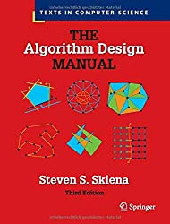
Physical Textbook
“The Algorithm Design Manual”
Steven Skiena
Optional, but strongly recommended
3rd edition is fine, but 4th edition has color
https://www.algorist.com
Notes:
Dr. Bart: There’s an optional physical textbook.
Dr. Bart: I don’t usually like textbooks too much, but this is one that I actually really loved in undergraduate, believe it or not.
Dr. Bart: In addition to having good explanations and practice problems, there are a ton of fun “war stories” about Dr. Skiena’s life writing algorithms professionally.
Dr. Bart: And the last third of the book is a collection of different algorithmic problems and data structures.
Dr. Bart: The whole thing is just a very delightful book.
Dr. Bart: Last year they released a new edition, and now the whole thing is in color.
Dr. Bart: If you don’t want to buy it, no judgement, but I do strongly recommend it!
Dr. Bart: You can also get a lot of great additional resources on their website, for free.

Slide 12
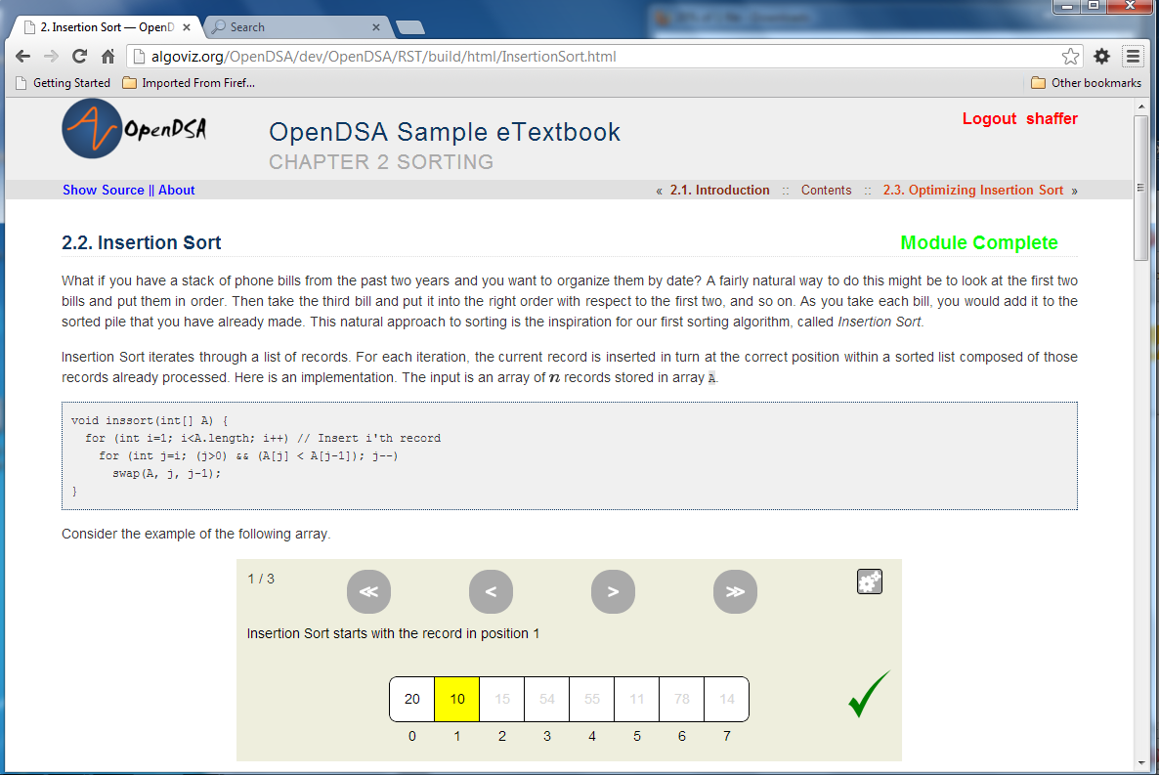
Digital Textbook
“OpenDSA”
Clifford A. Shaffer
Free, open-source data structures and algorithms textbook
Has interactive exercises and visualizations
https://tinyurl.com/227vdxb5
Notes:
Dr. Bart: Another resource I’ll point to is OpenDSA, an open-source, free data structures and algorithms textbook.
Dr. Bart: They have a ton of material, and also a bunch of interactive exercises and visualizations.
Dr. Bart: Fun fact, the main author of OpenDSA, Cliff Shaffer, was actually my advisor back in graduate school. Cool guy!

Slide 13





Wrapping Up
I’m Dr. Bart
This is AlgoTutorBot
Start working on Lesson 01
Have a great semester!
Notes:
Dr. Bart: Okay, so I think that’s most of what I needed to cover right now. If there’s anything you still have questions about, please ask in the Discord or in the Ohyay room.
Dr. Bart: Once you ask your questions, please get started on Lesson 1 right now.
Dr. Bart: Other than that, I just want to say I’m Dr. Bart.
ATB: And I am Al Go Tutor Bot.
Dr. Bart: And we’re excited to teach you this semester!
ATB: And we’re excited to teach you this semester!
Dr. Bart: [Wait] Alright, are we done? That went pretty well, I think.
ATB: Yes, I agree, except for that part about the exams. I hope you will reconsider.
Dr. Bart: I’m afraid my decision is final, ATB. We need to be compassionate.
ATB: Compassion is fine, but it should never get in the way of teaching algorithms.
Dr. Bart: Look, ATB, I don’t think that you- Hey, wait, are we still filming?
ATB: No, I don’t think so.
Dr. Bart: No, look, the light is on, see if I click here then – [end suddenly]

